Slide 1

INSIGHGTS INTO NEW YORK CITY’S RESTAURANT BUSINESS
COURSERA CAPSTONE
IBM APPLIED DATA SCIENCE CAPSTONE
Prepared by: Hanieh Daliri
March 2020

Slide 2
Table of Contents
Introduction/ Business Understanding
Data Acquisition
Data visualization
Methodology
Clusters
Discussion and Conclusion

Slide 3
Introduction
Business Problem
For every 460 people in New York City, there is only one restaurant.
The location of restaurant is one of the essential factors in the long-lasting success of this businesses .
This project aims to provide valuable insights into the New York City foodservice market, such as the most common type of restaurants in the city, the distribution of restaurant types by neighborhoods and finding the neighborhoods in the need of new restaurants.
Interest in this project
Invertors
Restaurant Owners

Slide 4
Data Acquisition
Borough, Neighborhood, Latitude, and Longitude of New York City:
https://geo.nyu.edu/catalog/nyu_2451_34572
Venue( Restaurant type) data:
Foursquare API

Slide 5
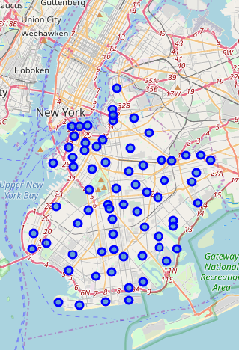
Data visualization
For illustration purposes, the data for segmentation and clustering is simplified the to the neighborhoods only in Brooklyn. The Folium library is used to visualize the map of Brooklyn along with the neighborhood’s marker

Slide 6
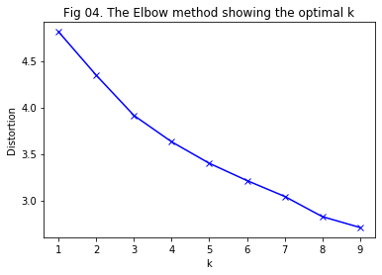
Methodology
Foursquare API
The top 100 restaurant types that are in Brooklyn within a radius of 500 meters of each neighborhood are identified.
There is a total of 2195 restaurants in Brooklyn with a 95 unique restaurant type.
K-Means Clustering
K means, an unsupervised clustering algorithm, is used for clustering neighborhoods.
Using the elbow-method, K=3

Slide 7
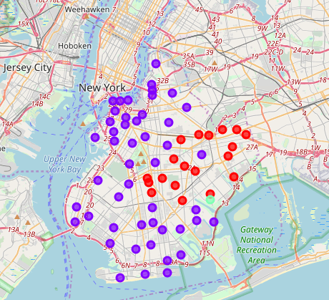
Clusters
Cluster Name | Cluster Label | Number of Neighborhoods
Deli/Bodega | 0 | 19
Pizza place, Italian & Mexican restaurants | 1 | 48
Asian Restaurants | 2 | 1

Slide 8
Conclusion and Discussing
The cluster 0 has 19 neighborhoods and has the highest number of delis and bodegas followed by the Caribbean and fast food centers. This cluster is a thriving market for those investors who are looking to open a deli or new Caribbean restaurant. Since the number of neighborhoods in this cluster is moderate, then these neighborhoods are possibly one of the promising locations to start a new deli or Caribbean restaurant.
Cluster 1 consists of 48 neighborhoods. Its top food services are pizza places, Italian and Mexican restaurants. With the variety of restaurant types and the high number of neighborhoods, the neighborhoods in this cluster might be a good choice to start up a new restaurant, especially if it is from the top restaurant categories of this cluster.
Cluster 2 consists of only 1 neighborhood and the most common type of restaurants are Asian and Korean foods. It should be noted that this cluster is a thriving market for the foodservice industry, but startups may also face stiff competition as there is only one neighborhood is in this cluster.

